Slide 1
Covariance
Notes:
https://docs.google.com/spreadsheets/d/1IwgftHmcPGa8ZVsklt6-K-ep4C7VezHZ3yhhqe6f3GA/edit#gid=1767382413

Slide 2
Covariance
Covariance is the measure of the relationship between two variables
It is a measure of the extent to which two random variables change together i.e. a measure of the joint variability two variables
Positive covariance: the variables tend to move in the same direction
Negative covariance: the variables tend to move in opposite directions.
Covariance can effectively convey the direction of the joint variability of two variables, but not the strength of the relationship, because it is not normalized.

Slide 3
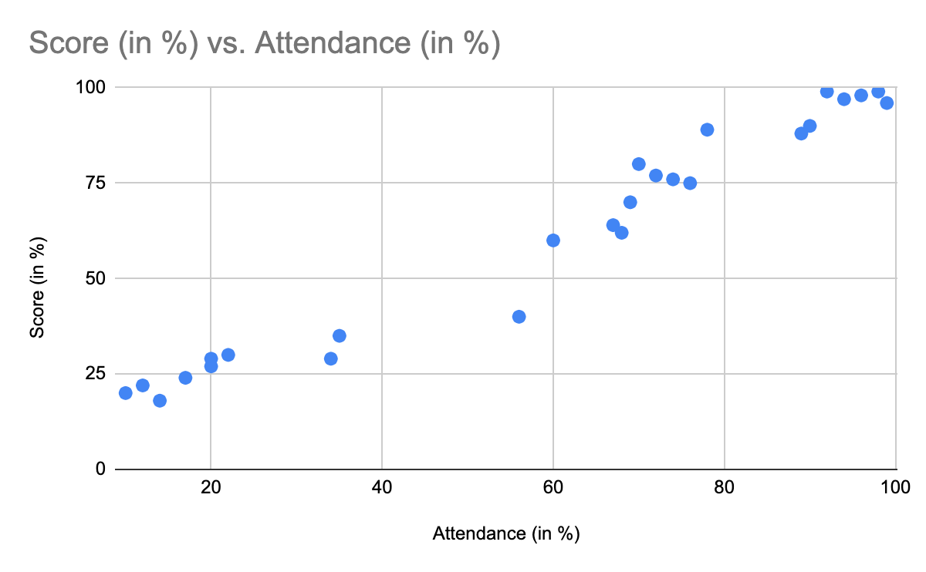
Covariance
In this example, students who have higher attendance, in general, also obtain a higher score, which suggests a positive covariance between the Attendance and the Score variables.
We can also see how other variables (parental income, educational; background, etc) affect the score, by analyzing the covariance between these variables and the score.

Slide 4
Covariance
Variance is computed using the formula 𝝈² = ∑(x - μ)² / n
Covariance, on the other hand, is computed as:
Cov(X, Y) = ∑ (x_{i} - μ_{x})(y_{i} - μ_{y}) / (n - 1)
where, X & Y represents the independent variables
n represents the number of data points in the sample,
μ_{x} represents the mean of the X, and
μ_{y} represents the mean of the dependent variable Y
The reason (n-1) is used in the denominator instead of n is to obtain a more unbiased estimate of the population value

Slide 5
Covariance
Due to lack of normalization, the value of the covariance does not convey any useful information about the strength of the relationship between two variables. (only the sign).
For two jointly distributed real-valued random variables, X and Y, the covariance can also be defined as follows.
cov(X, Y) = E[(X - E[X]) (Y - E[Y])]
where
E[X] denotes the mean μ_{x}
E[Y] denotes the mean μ_{y}
X - E[X] -> x - μ_{x}
Y - E[Y] -> y - μ_{y}

Slide 6
Covariance
Calculate covariance for the following data set:
x: 2.1, 2.5, 3.6, 4.0 (mean = 3.1)
y: 8, 10, 12, 14 (mean = 11)
Cov(X,Y) = Σ(x_{i}-μ)(y_{i}-ν) / (n-1)
= (2.1-3.1)(8-11)+(2.5-3.1)(10-11)+(3.6-3.1)(12-11)+(4.0-3.1)(14-11) /(4-1)
= (-1)(-3) + (-0.6)(-1)+(.5)(1)+(0.9)(3) / 3
= 3 + 0.6 + .5 + 2.7 / 3
= 6.8/3
= 2.267

Slide 7
Applications of Covariance
Covariance is used for feature selection in algorithms such as Principal Component Analysis (We will cover this topic during Machine Learning Lecture).
Covariance is used in finance while building portfolios to determine the proportion of different assets the investors should invest in.
Covariance is also used in molecular biology and genetics to study secondary and tertiary proteins or RNA structures.

